Slide 1
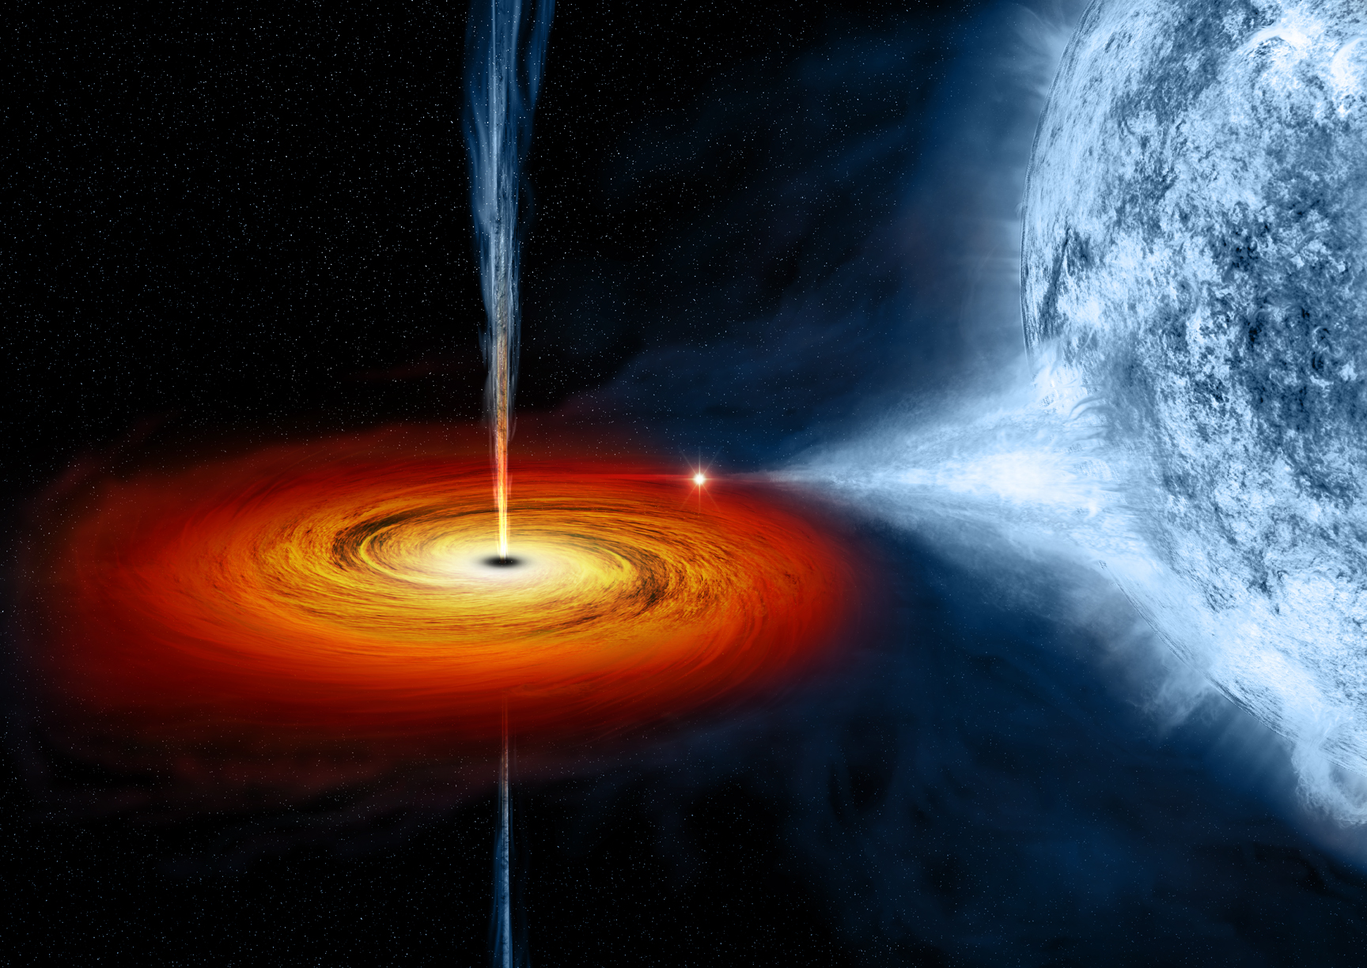
Black Holes
Vinay Vikramaditya
14416

Slide 2

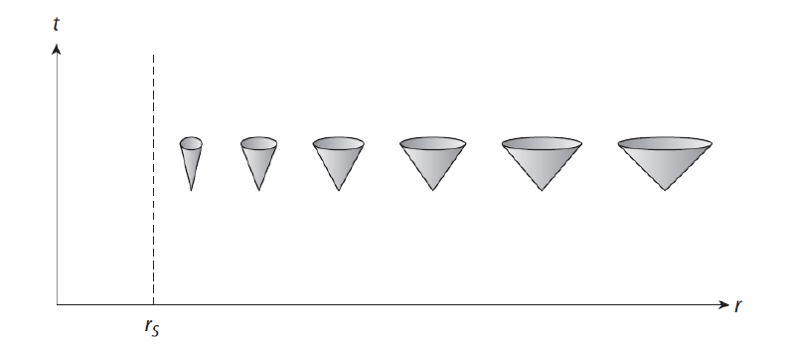
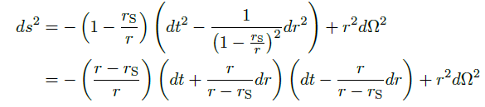
Kruskal-Szekeres Coordinates
Radial Rays:

Slide 3


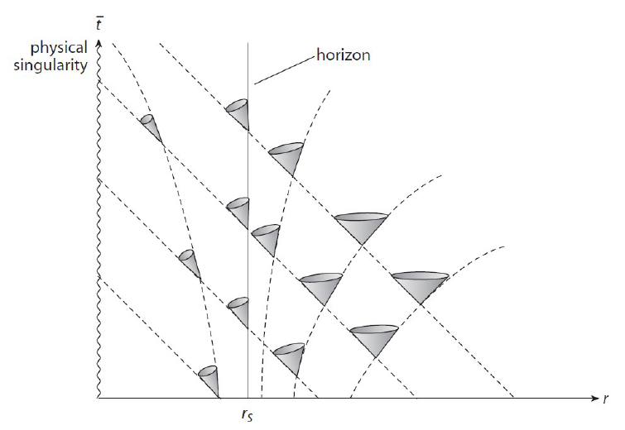








with

Slide 4





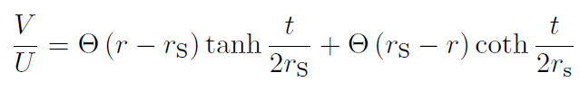

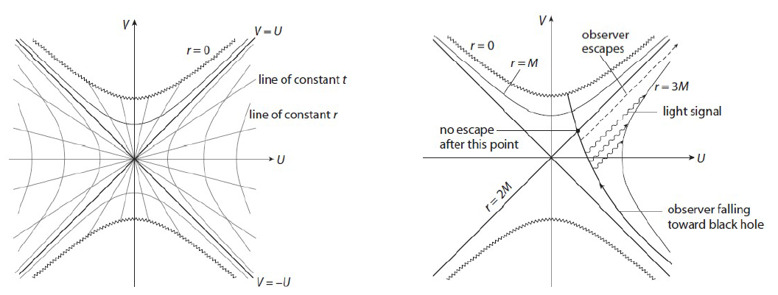
Radial Rays have slope ±1
Lines of constant t correspond to straight lines with constant slope passing through the origin.
Lines of constant r are hyperbolae: Vertically oriented for outside horizon and horizontally for inside it.

Slide 5
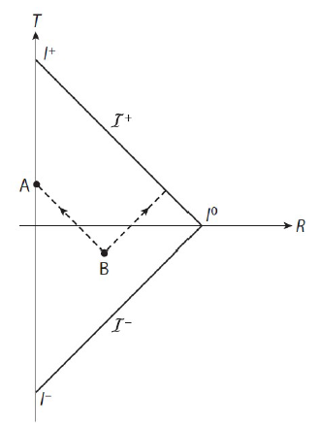
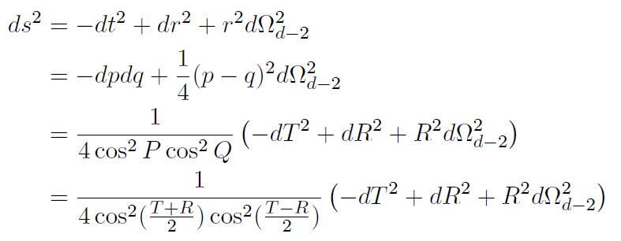



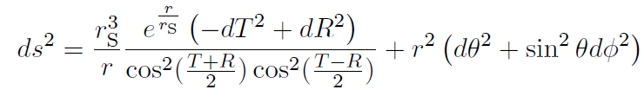
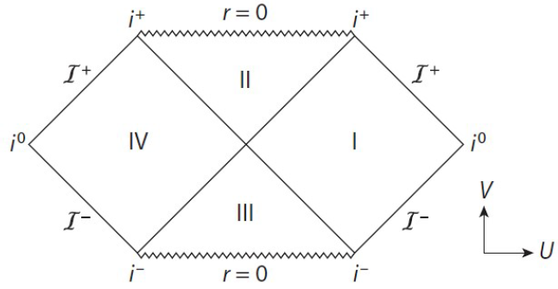

Penrose Diagrams
r = r(T,R) is a solution of

Slide 6








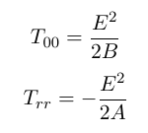



Charged Black Hole: Reissner-Nordstrom Solution
Spherical symmetry
Only non-vanishing component:
Maxwell’s equation
Using boundary conditions we have AB=1 as in Schwarzschild Solution

Slide 7



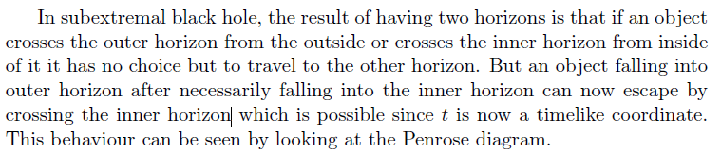
with
Q=M means both horizons coincide and this is called an extremal charged/Reissner-Nordstrom black hole (Extreme RNBH)

Slide 8


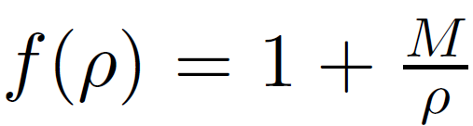


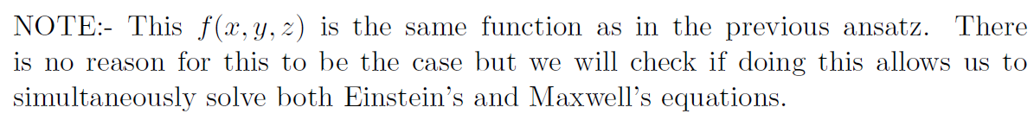
Extremal Reissner-Nordstrom Black Hole
This suggests we make a change of coordinates as follows
Metric Ansatz for Multiple Extremal RNBHs
Vector Potential Ansatz for Multiple Extremal RNBHs

Slide 9


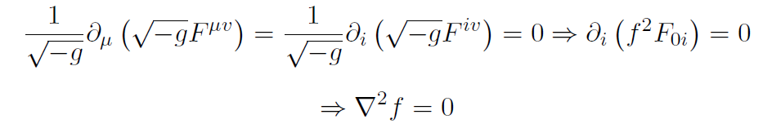
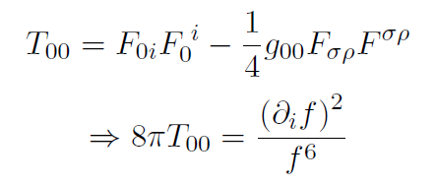
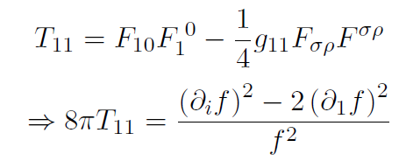
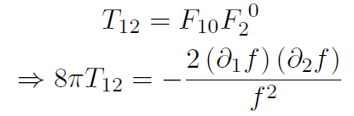


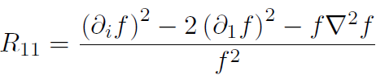



Maxwell's Equation
Remarkably the same condition as Maxwell’s equation!

Slide 10
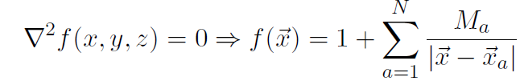
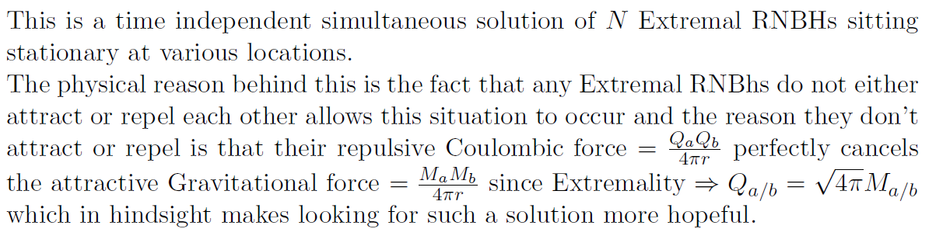
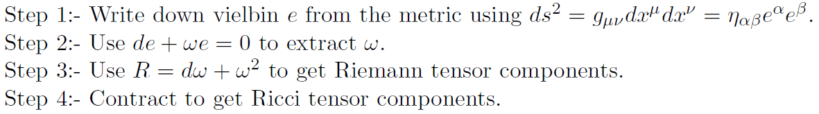
Computation of Ricci Tensor

Slide 11



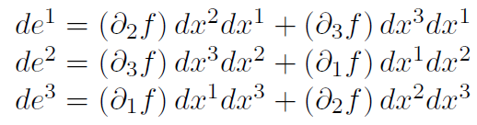




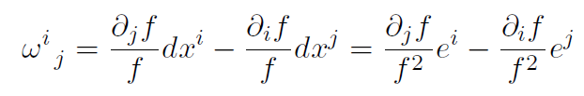
Step 1
Step 2
No dt term

Slide 12

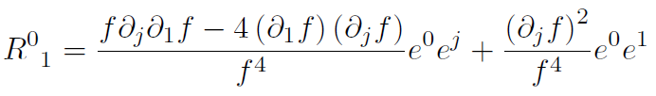

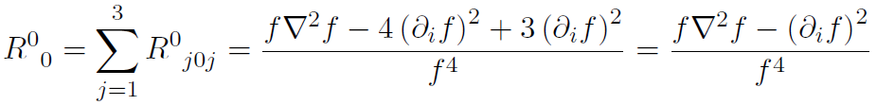




Step 3 and 4

Slide 13
